Slide 1
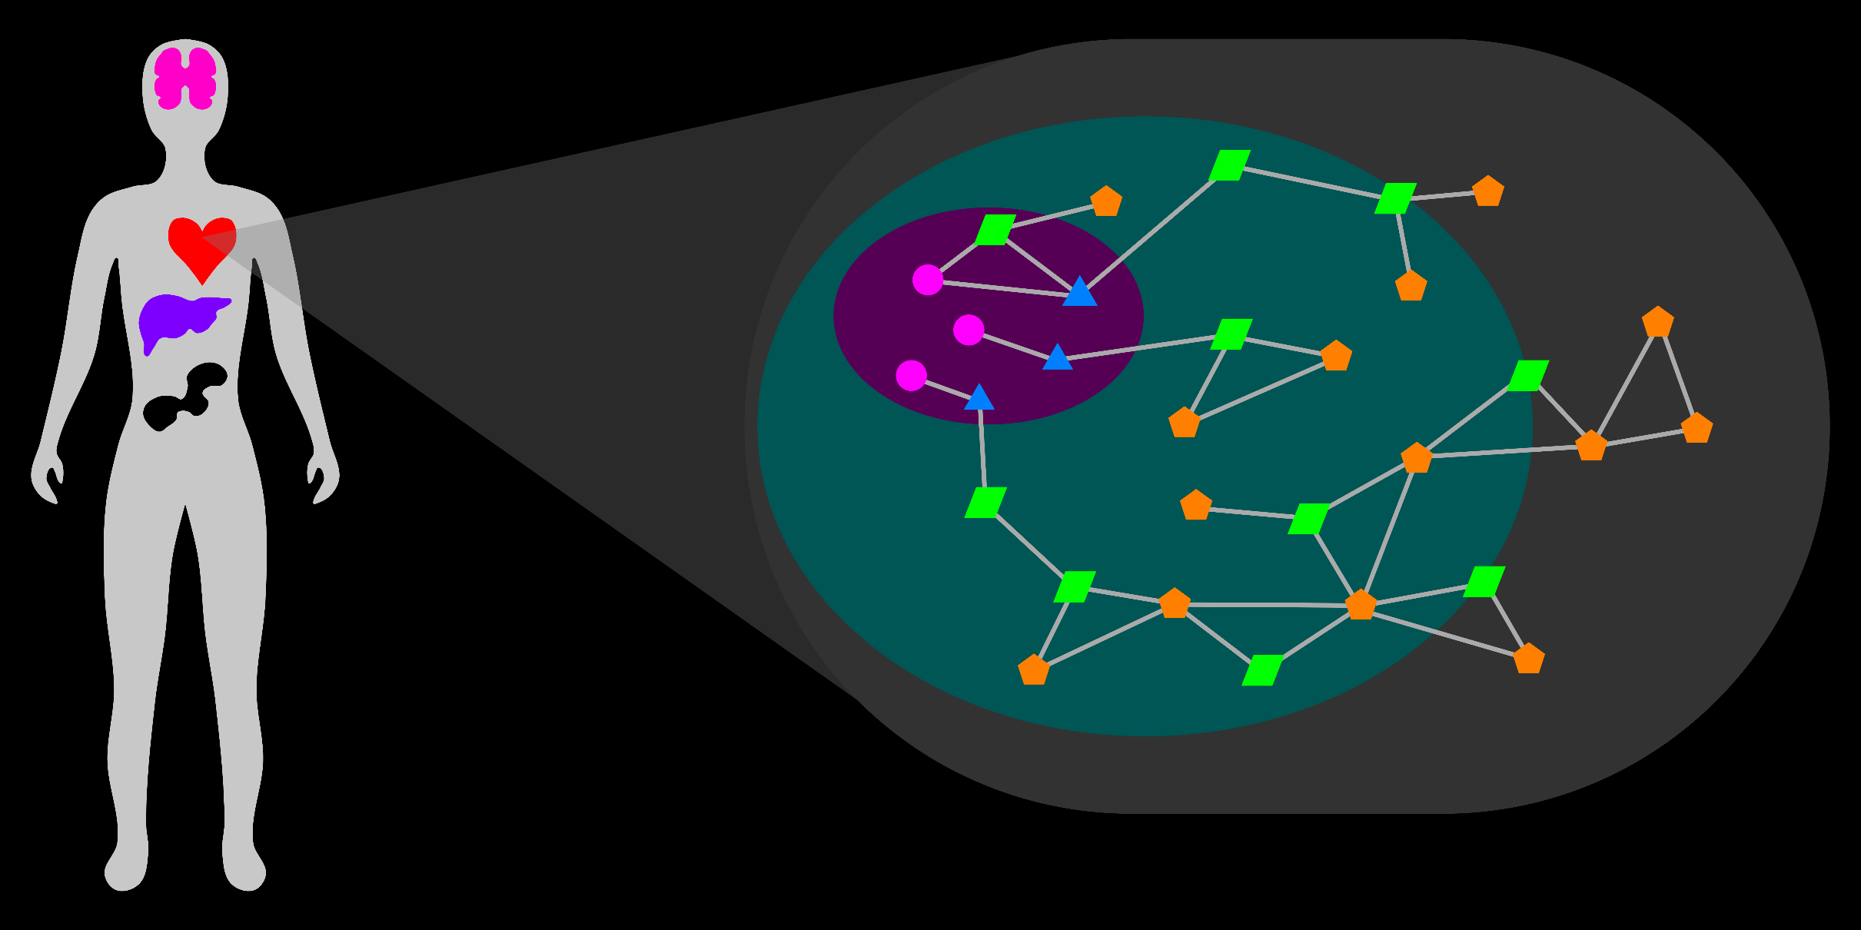
Visual Exploration and Analysis of the Metabolic Network
Rutter Team Meeting
15 December 2016
T Cameron Waller

Slide 2
Relevance, Goal
Biology
Biotechnology
Pharmacology
Medicine
Notes:
Metabolism sustains life.
Metabolism is an integral part of the biological system.
Defects in metabolism drive many human diseases, including obesity, diabetes, cardiovascular disease, and cancer.
The goal of this project is to develop computational methods to support the study of metabolism in domains of biology, biotechnology, pharmacology, and medicine.

Slide 3
Metabolic Network: Entities (Nodes)
Entities:
Genes
Transcripts
Proteins
Metabolites
~ 70,000
> 70,000
~ 30,000
~ 30,000
Properties:
Compartment
Cofactor
Attributes:
Modification
Abundance
Notes:
Metabolism is a system or network of biological entities and relations between them.
Entities: Genes, Transcripts, Proteins, Metabolites
Represent entity by node or graph vertex.

Slide 4
Metabolic Network: Relations (Links)
Entities:
Genes
Transcripts
Proteins
Metabolites
~ 70,000
> 70,000
~ 30,000
~ 30,000
Relations:
Encoding:
Properties:
Directionality
Rate
Pathway
Anabolism/Catabolism
Reduction/Oxidation
Expression:
Regulation:
Catalysis:
Transport:
Reaction:
Notes:
Relations:
-Encoding: Biological Sequences, Genetic Code (Gene-Transcript-Protein)
-Expression: Regulation of transcription and translation (Protein-Gene, Protein-Transcript)
-Regulation: Allosteric regulation (Metabolite-Protein), Post-translational modification of proteins (Protein-Protein)
-Catalysis: Enzymatic catalysis (Protein-Metabolite)
-Transport: Metabolite transport (Protein-Metabolite)
-Reaction: Chemical reactions (Metabolite-Metabolite)
Represent relation by link or graph edge.
Need to consider (and associate data to) entire network.
Too many types and counts of entities and relations to represent simultaneously.
Essential to represent subset according to interest.

Slide 5
Metabolic Network: Representation
Reactant
Metabolites
Product
Metabolites
Reaction
Genes
Transcripts
Proteins
Notes:
Metabolism functions as a cooperative, inter-connected whole.

Slide 6
Study of Metabolism
Design Experiments
Holistic Context
2) Interpret Results
Challenges
1) Complex System
2) Data-Heavy
3) Non-specialists
Notes:
The study of metabolism
1) Design experiments to study functions of individual entities or processes.
2) Interpret results, especially from 'omics technologies (genomics, transcriptomics, proteomics, metabolomics).
In both of these cases, it is important to consider the holistic context of the metabolic system.
Challenges in Study of Metabolism
1) Metabolism is a complex system.
2) High-throughput methods and data-heavy results, especially 'omics technologies.
3) Non-specialist, non-expert investigators.

Slide 7
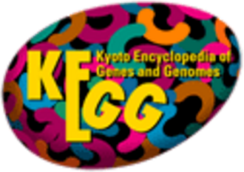

Current Technology
Databases
KEGG
MetaCyc
UniProt
Models
Recon 2.2
Explorers
MetScape
KEGG Atlas
Escher
Notes:
Describe current technology very briefly.

Slide 8
Current Technology
Notes:
Describe current technology very briefly.

Slide 9
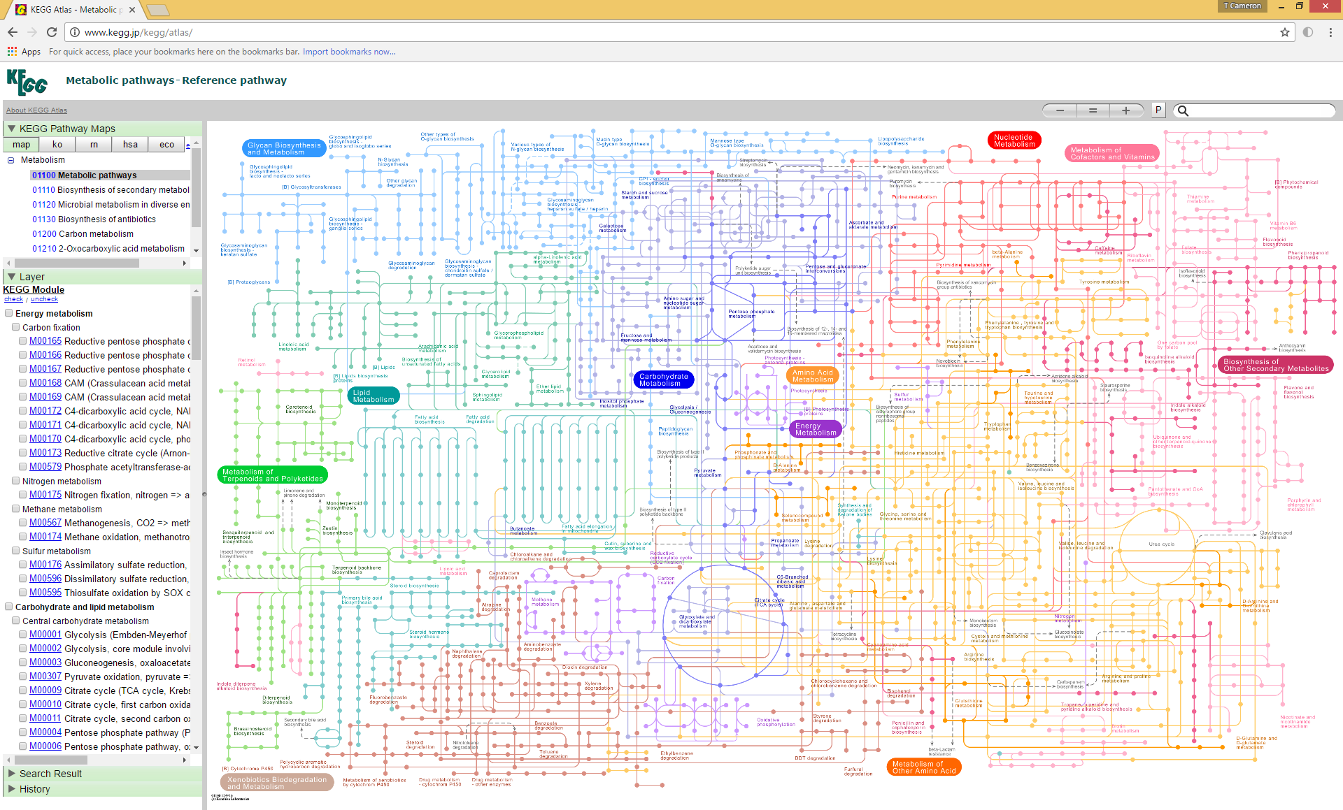
Notes:
KEGG Atlas
MAP 01100 Metabolic Pathways
This map from KEGG Atlas represents the metabolic network between _____ metabolites.
The map only represents "most important" metabolites in reactions.
It organizes nodes for metabolites spatially by metabolic pathway or process.
There is no clear indication of compartmentalization.
This map-like layout is manually-drawn and is static.

Slide 10
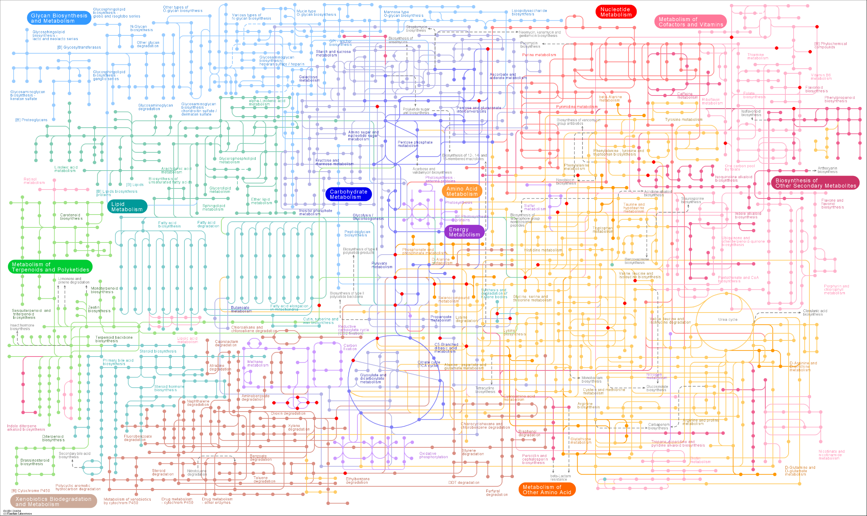
Notes:
KEGG
MAP 01100 Metabolic Pathways
Pyruvate Metabolism
Highlight all metabolites within 1 reaction of pyruvate.
Suppose we are interested in a subset of this metabolic network.
There is no support for custom queries (topology-based or otherwise).
I manually traced edges from the node for pyruvate to find all metabolites that relate directly (within 1 reaction).
Finding all 35 metabolites, copying their identifiers, and highlighting them on the map took me 1 hour.
Many sets of metabolites of interest (such as this set) are not all within the same pathway.
In many cases the relevant portion of the metabolic network traverses pathways.
Although all of these metabolites relate directly to pyruvate, their spatial positions depend on pathway.
The layout de-emphasizes and even distorts the connectivity between these metabolites.
The map replicates several nodes (including pyruvate's) in an ambiguous way.

Slide 11
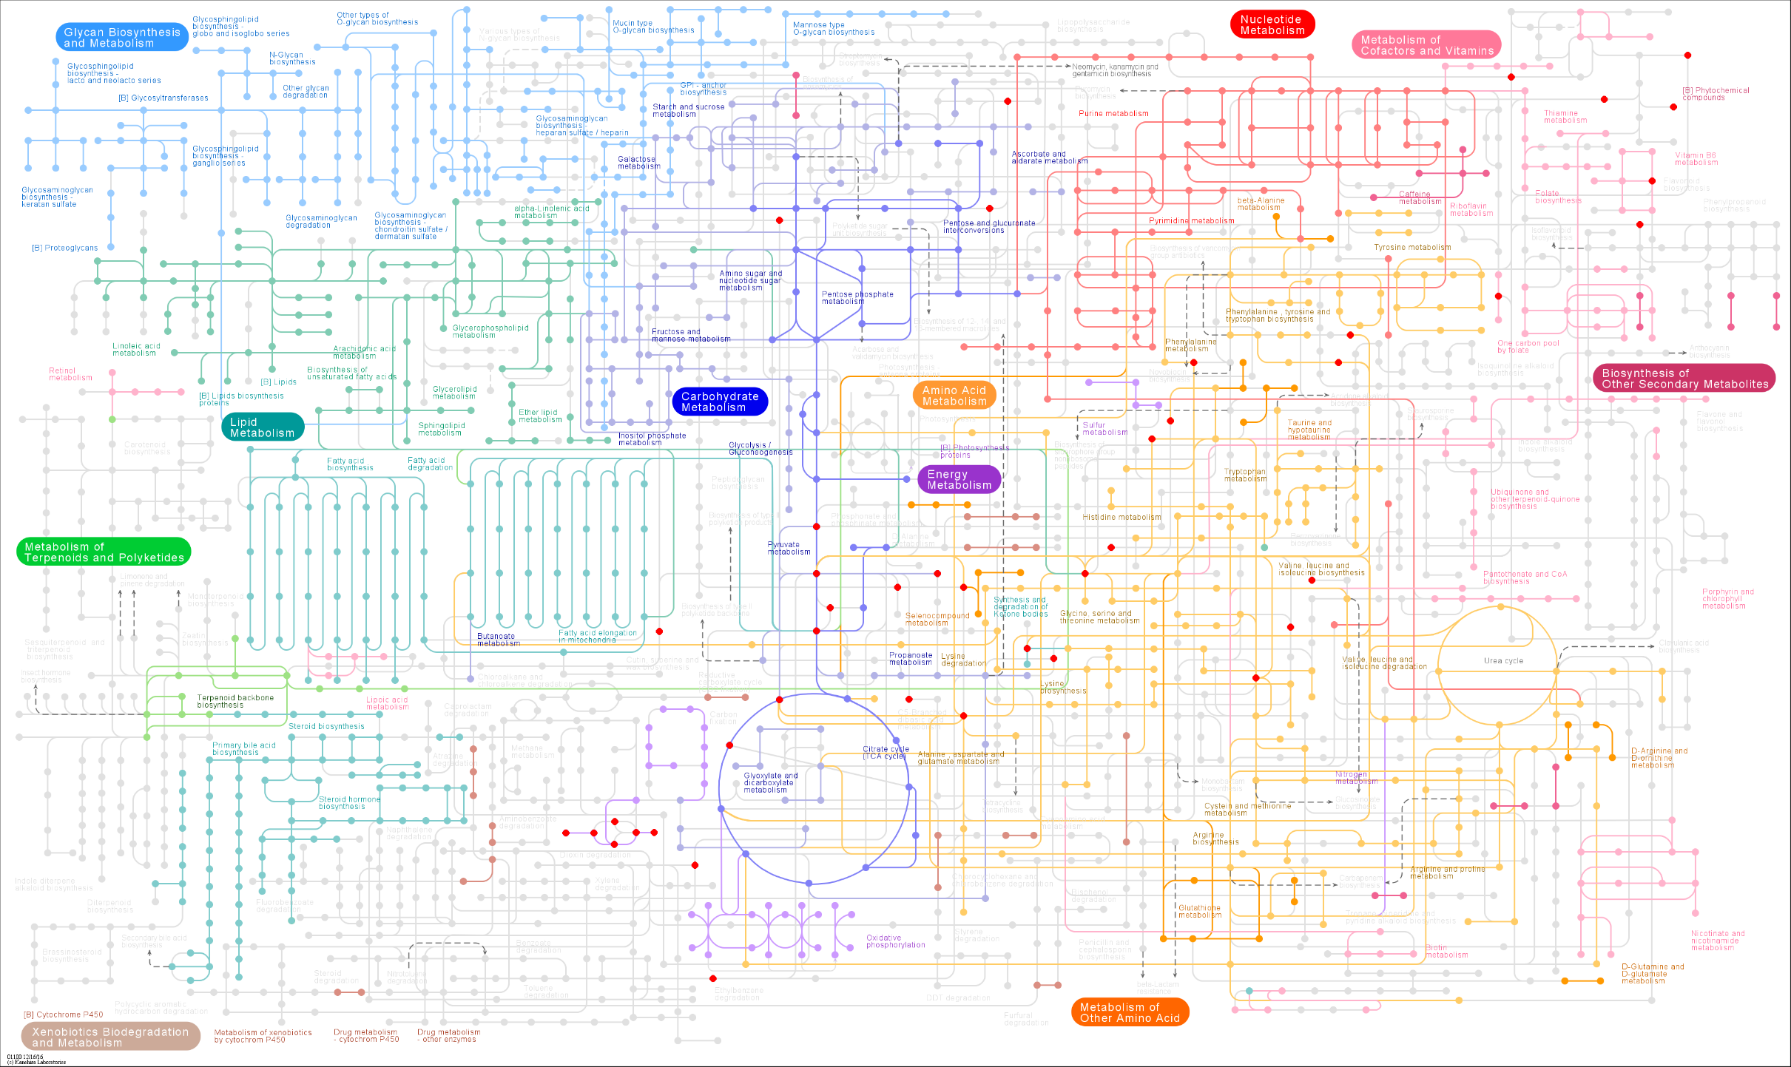
Notes:
KEGG
MAP 01100 Metabolic Pathways
Human

Slide 12
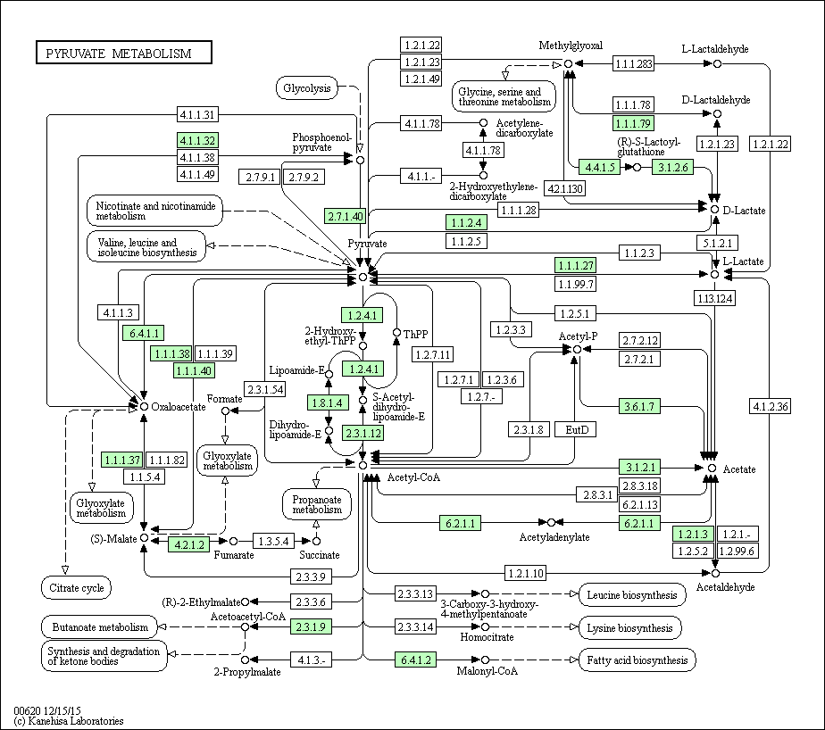
Notes:
KEGG
Map Pyruvate Metabolism
Because KEGG uses static maps for "distinct" pathways, the user must find metabolites by searching multiple, separate maps.

Slide 13
Current Technology
Notes:
Describe current technology very briefly.

Slide 14
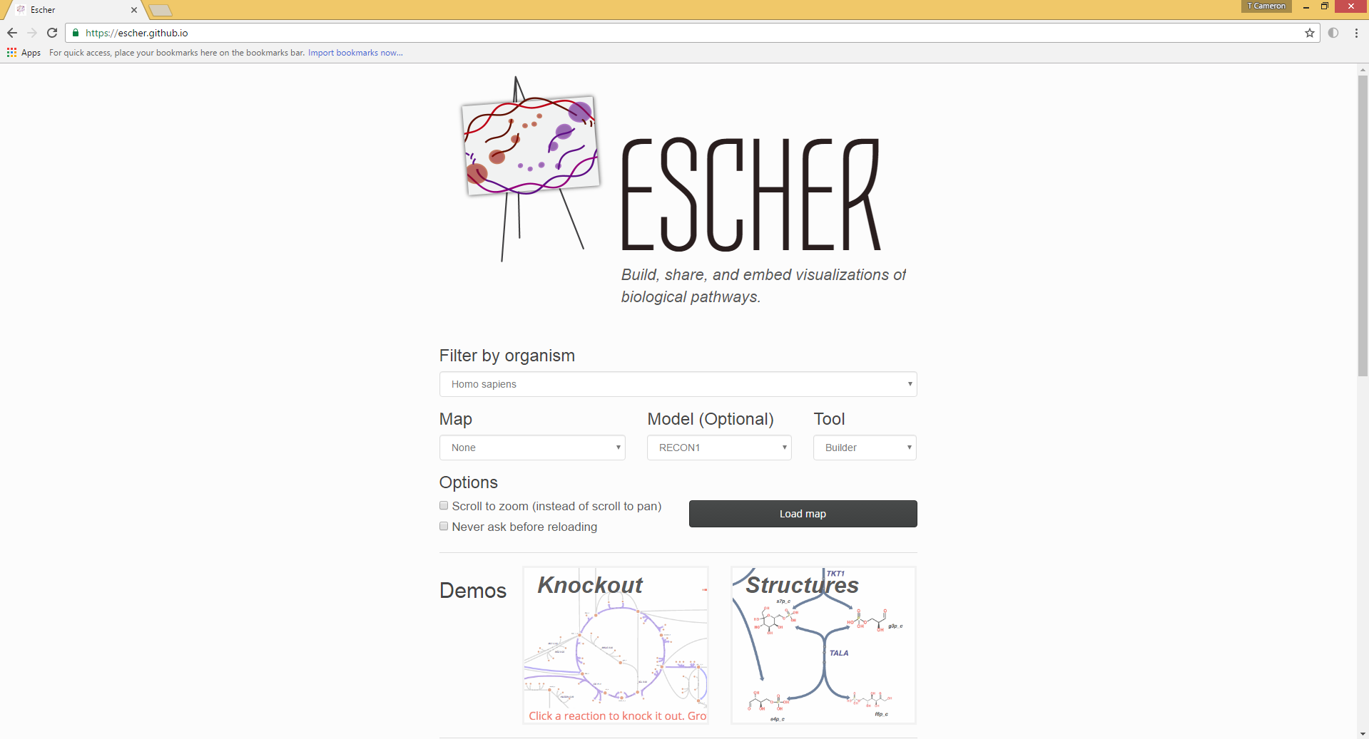
Notes:
Escher relates information from metabolic models (systems biology) to maps with manual, static layouts.

Slide 15
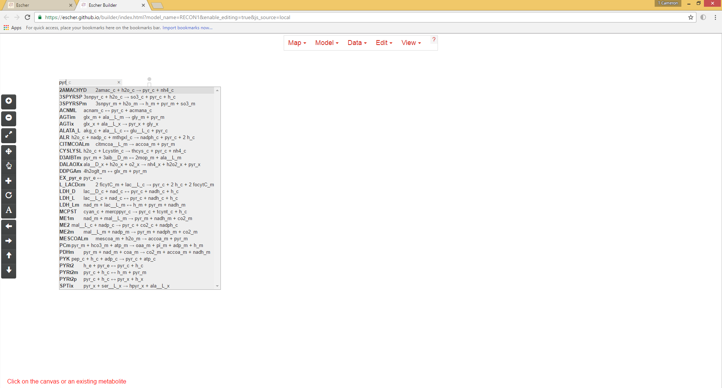

Slide 16
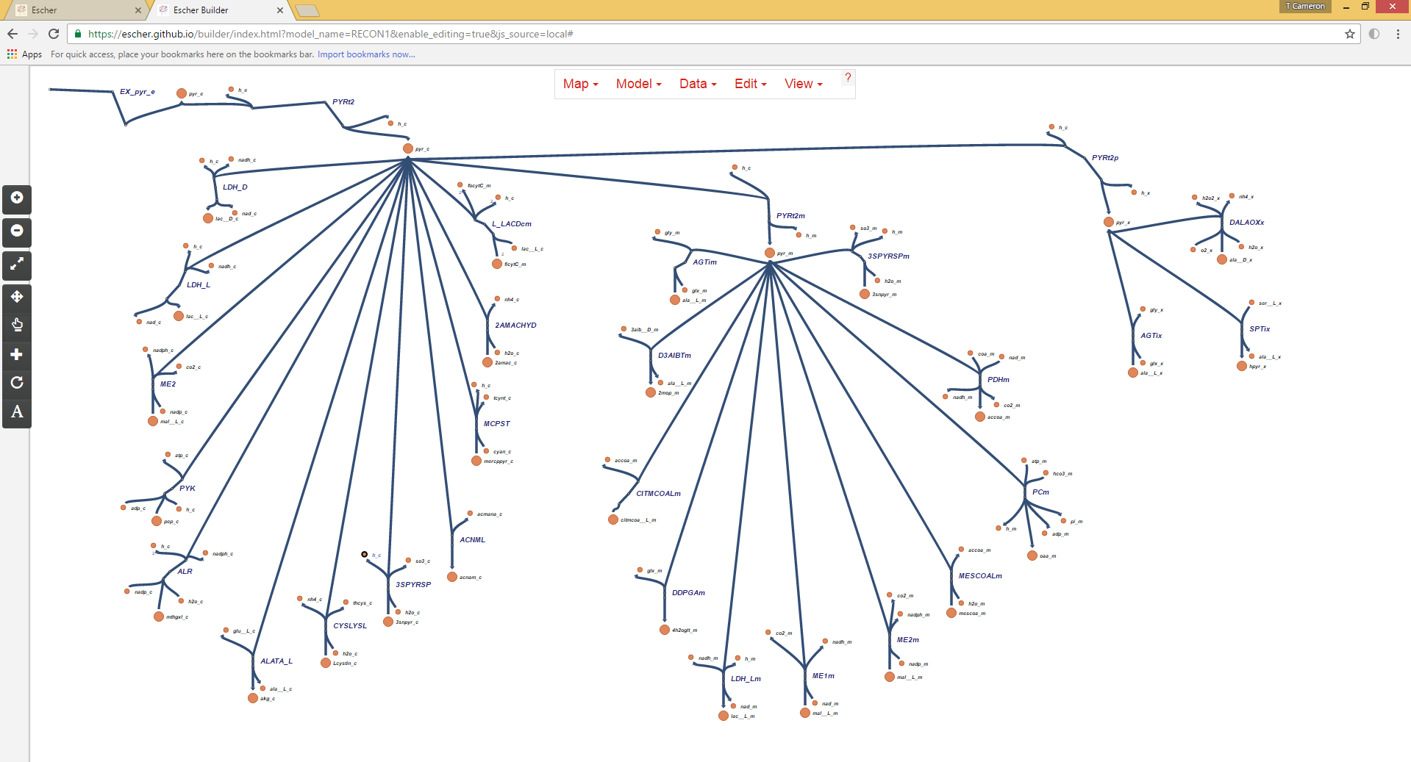
Notes:
Escher relies on manual, static layouts for readability.
Escher is inappropriate for efficient exploration by custom queries.

Slide 17
Notes:
The following images are sketches to demonstrate ideas.

Slide 18
Challenges
Holistic Context versus Specific Detail
1) Query against entire Model
Custom, pathway independent
Flexible, dynamic layouts
2) Visualize Experimental Results
Notes:
1) Preserve holistic context while providing specific detail.
Metabolism functions as a cooperative whole.
Need to consider and study metabolism holistically.
Metabolism is also vast and complex.
Need to consider relevant portions of metabolism in detail according to interest.
2) Represent selections of the network flexibly and dynamically.
Connection and cooperation between members of the metabolic system traverse and transcend typical pathways.
Interest sets of metabolism are custom and case-specific with great variety.
Need for automatic, dynamic representations that are clear.
3) Associate experimental results (data) with context of metabolic system.

Slide 19
Design Ideas
These are sketches to demonstrate ideas…
Notes:
The following images are sketches to demonstrate ideas.

Slide 20
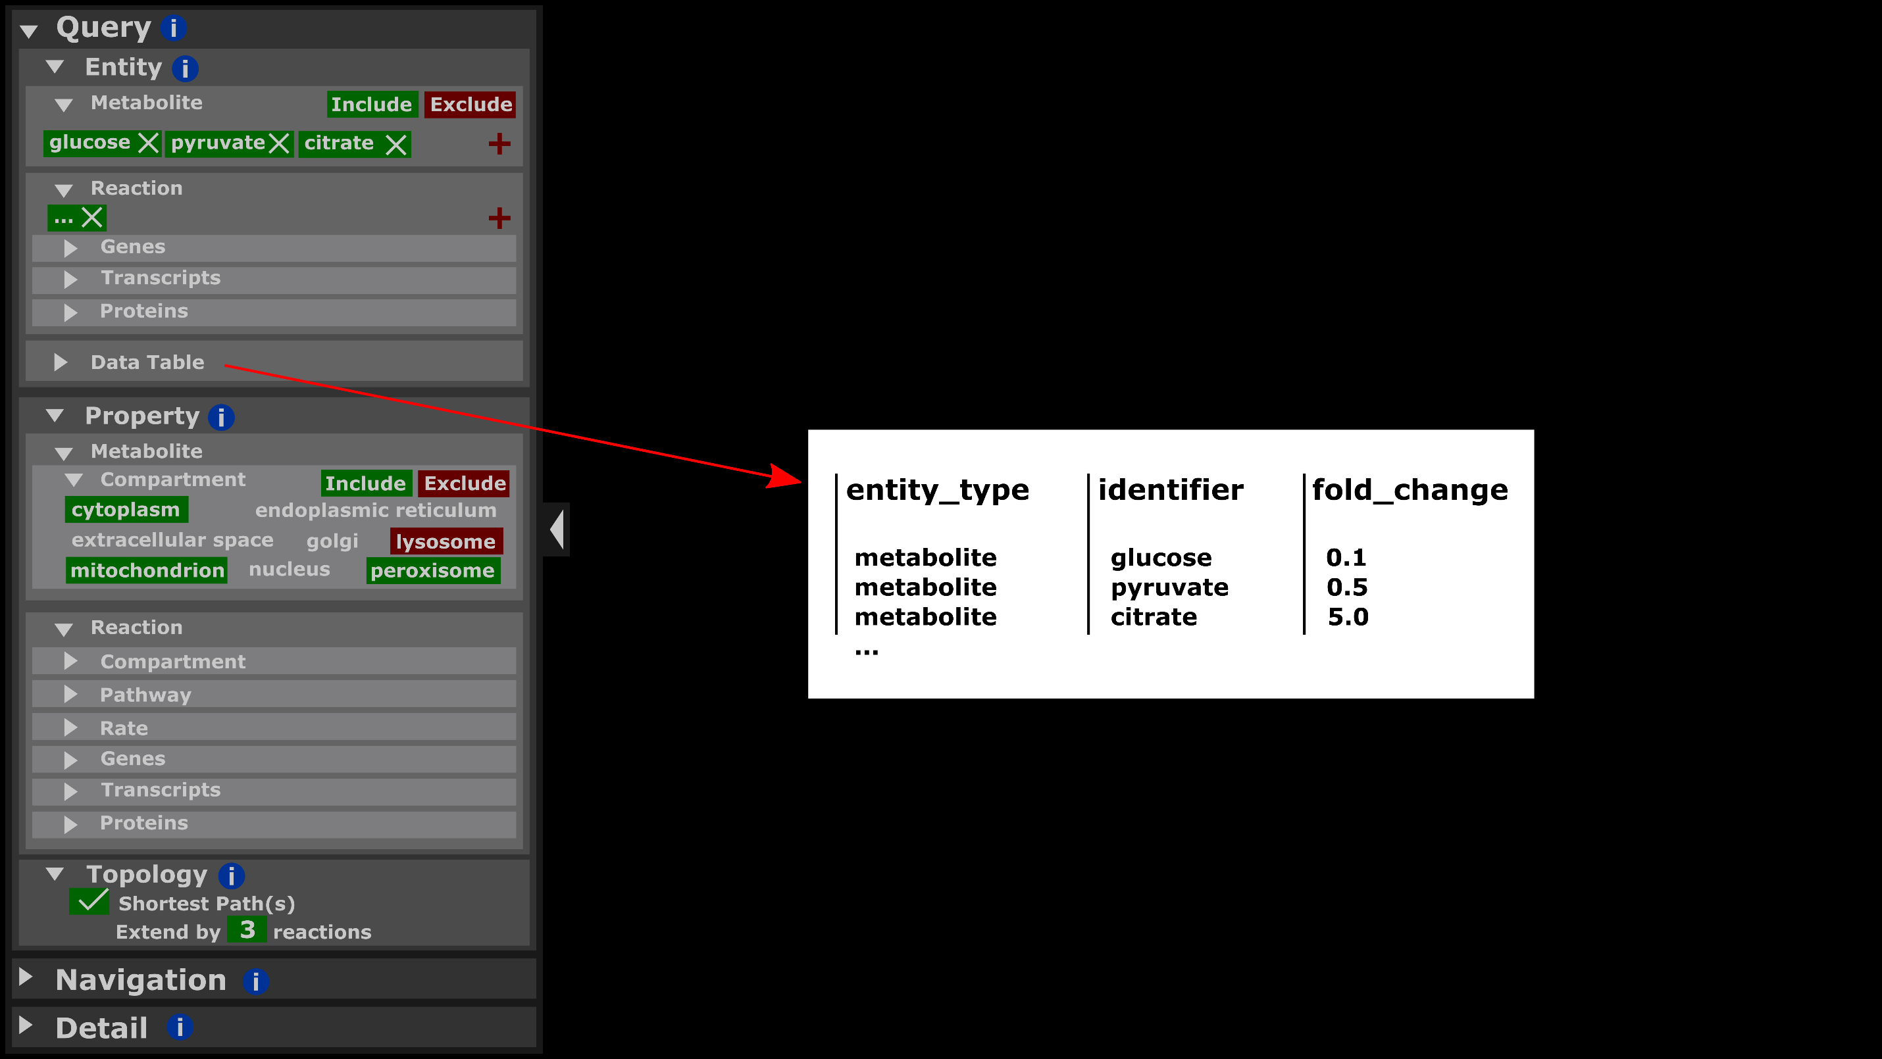
Select paths between multiple nodes.
Select nodes and links by property/attribute.
Select paths by proximity.
Notes:
The following images are sketches to demonstrate ideas.

Slide 21
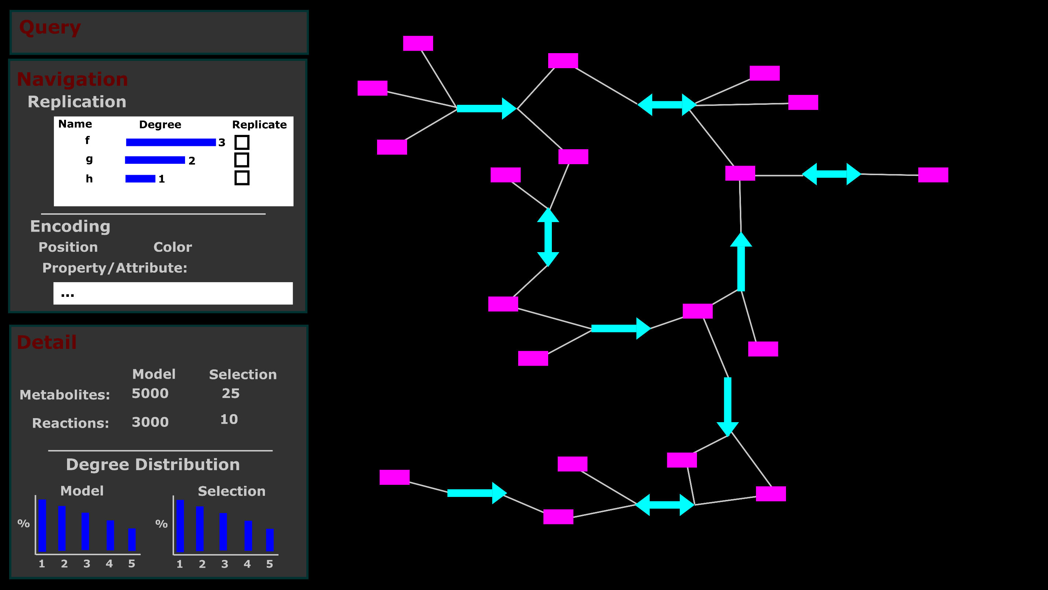
Replicate nodes with high degrees.
Represent properties/attributes on network.
Detail on model and selection.
Network representation.
Notes:
Exploration Tasks
1) Represent selections of the metabolic network visually.
-Nodes and links.
-Flexible, dynamic representation to accommodate custom selections.
2) Display network information (distribution of degree, betweenness centrality, and sets) for entire model and selection.
3) Provide option to replicate nodes with high degrees.
4) Represent properties of nodes and links on the visual network.
-Arrange nodes and links in positional groups for sets (cellular compartment, pathway).
-Color nodes and links for sets (pathway).
5) On selection of nodes or links, display summary information for metabolites (common reaction partners, set
distribution) or reactions (genes, transcripts, proteins).

Slide 22
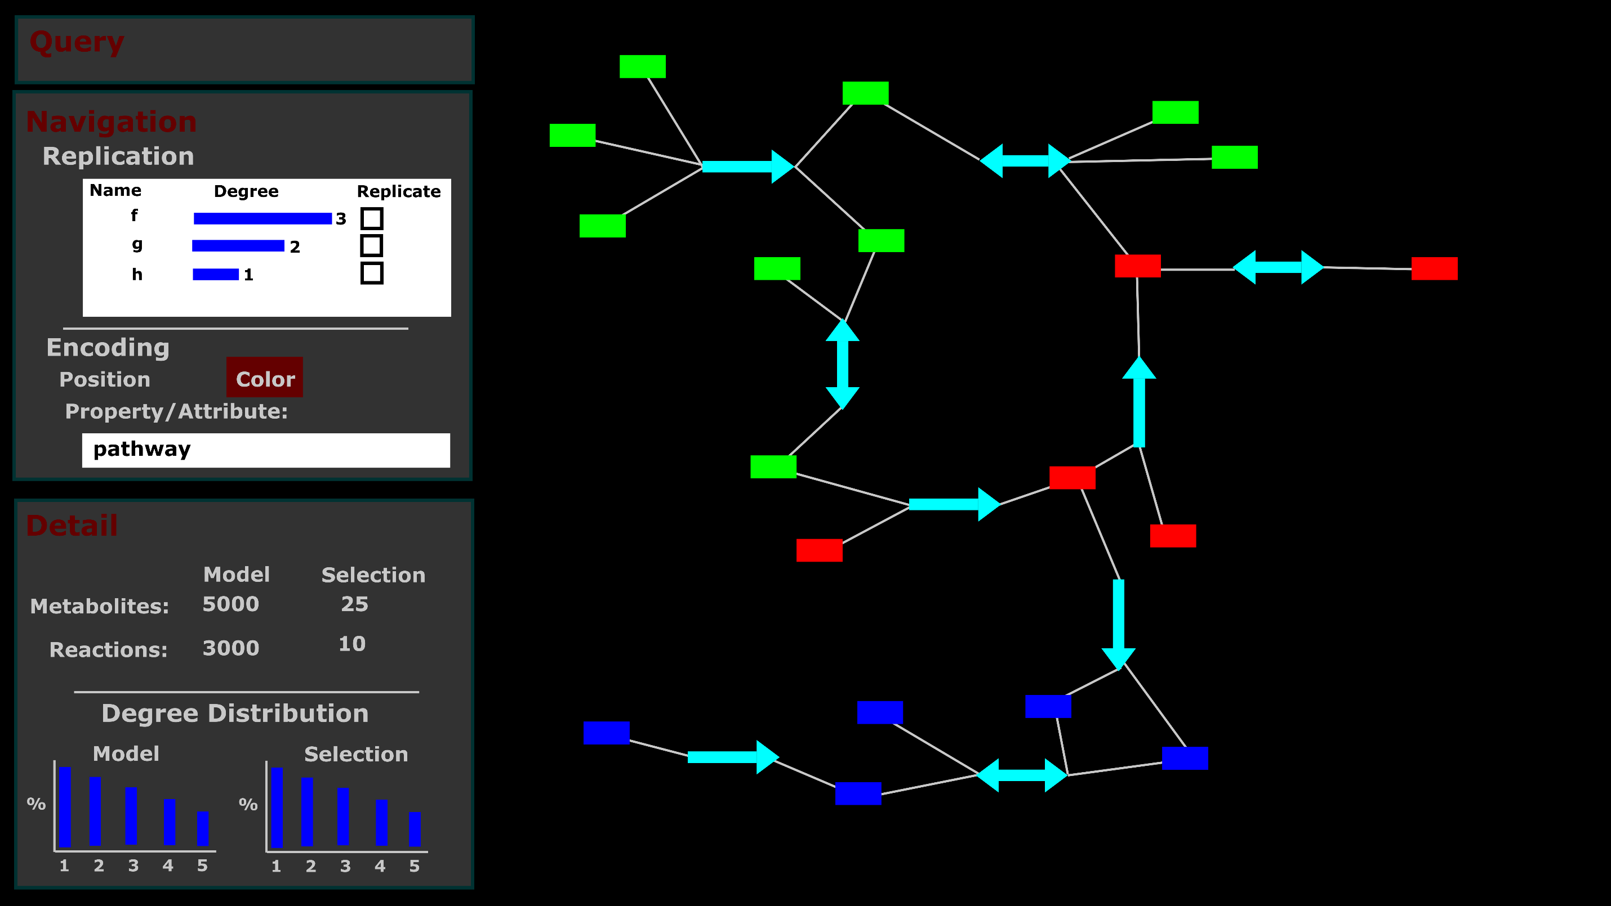
Represent property by color.

Slide 23
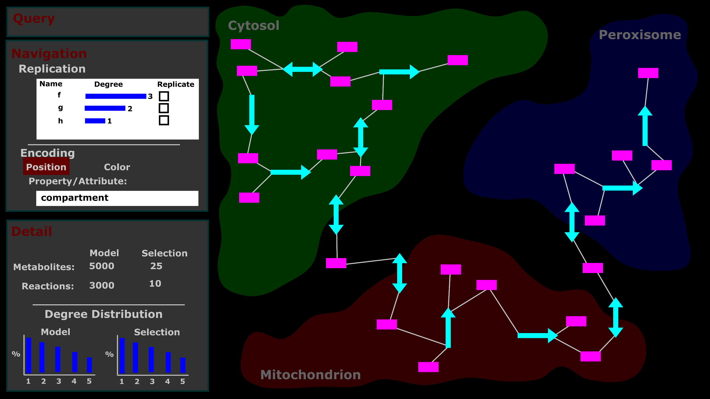
Represent property by position.

Slide 24
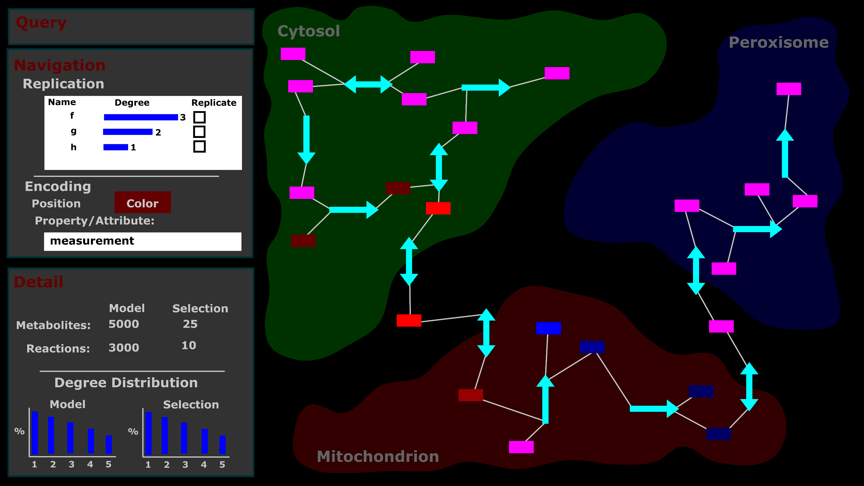
Represent quantitative attribute by color.
Notes:
Measurement Tasks
1) Represent selection of specific quantitative attribute by color saturation on the network.
-Either nodes for metabolites or links for genes, transcripts, or proteins.

Slide 25
Prototype
An early prototype…
Notes:
https://tcameronwaller.github.io/profondeur/

Slide 26
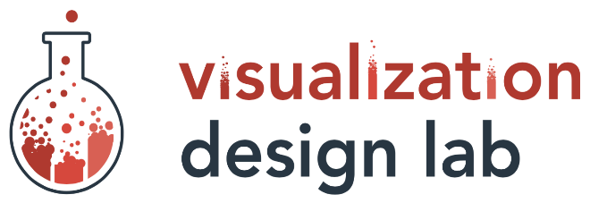



Acknowledgements
Teams:
Rutter Lab
(We need a logo!)
Visual Design Lab
Support:
National Institutes of Health
Training Program
Computational Metabolism
1T32DK11096601
Mentors:
Alexander Lex
Assistant Professor
Jared P Rutter
Professor
Committee:
Brian E Chapman
James E Cox
Adam L Hughes
Janet Iwasa

Slide 27
Discussion Subjects
Publish in Comp Sci, Bioinfo, or Computational Biology?
Which conferences?

Slide 28
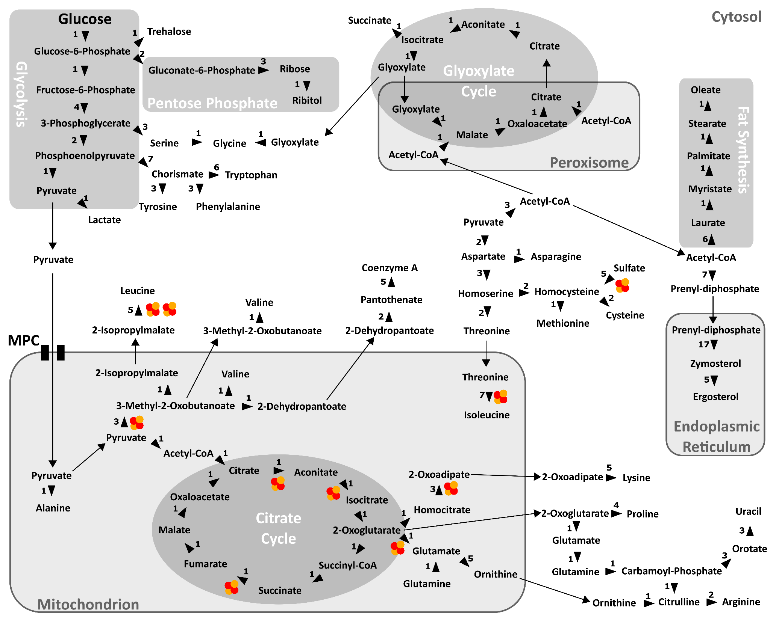
Notes:
Incomplete representation of metabolism
Arbitrary bias
Neglect of potentially-relevant nodes and links
Poor mapping of data
Map-like layout distorts network connectivity/topology

Slide 29
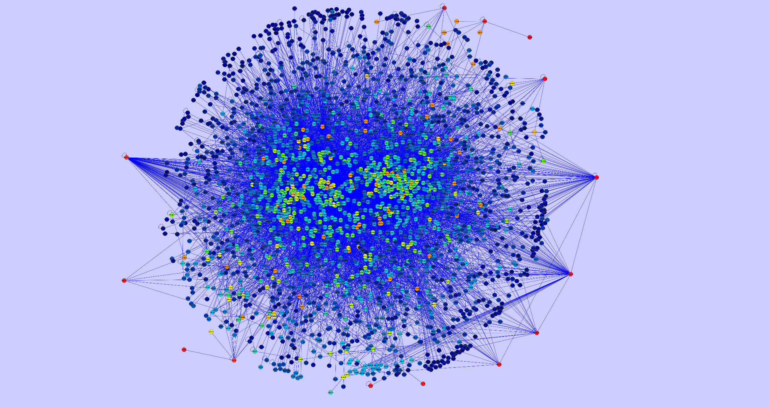
Gabor Ivan, Vince Grolmusz. Bioinformatics. 2010.

Slide 30
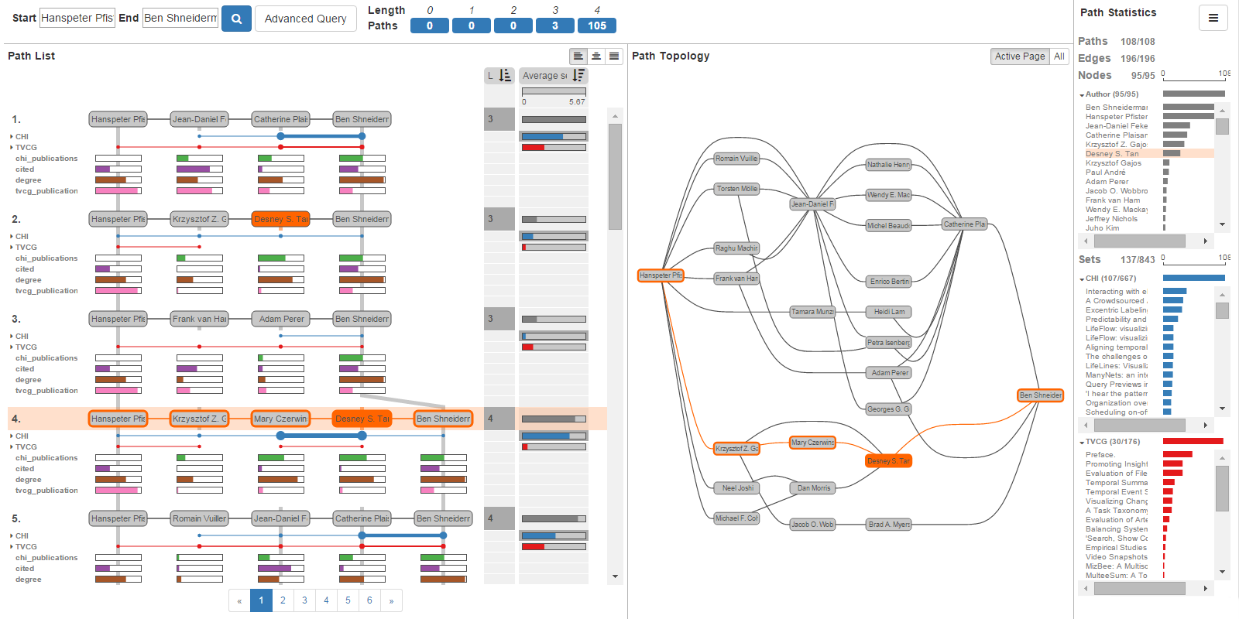
Network Visualization: Query-Based Exploration And Analysis
PathFinder
Christian Partl, … Alexander Lex. EuroVis. 2016.

Slide 31
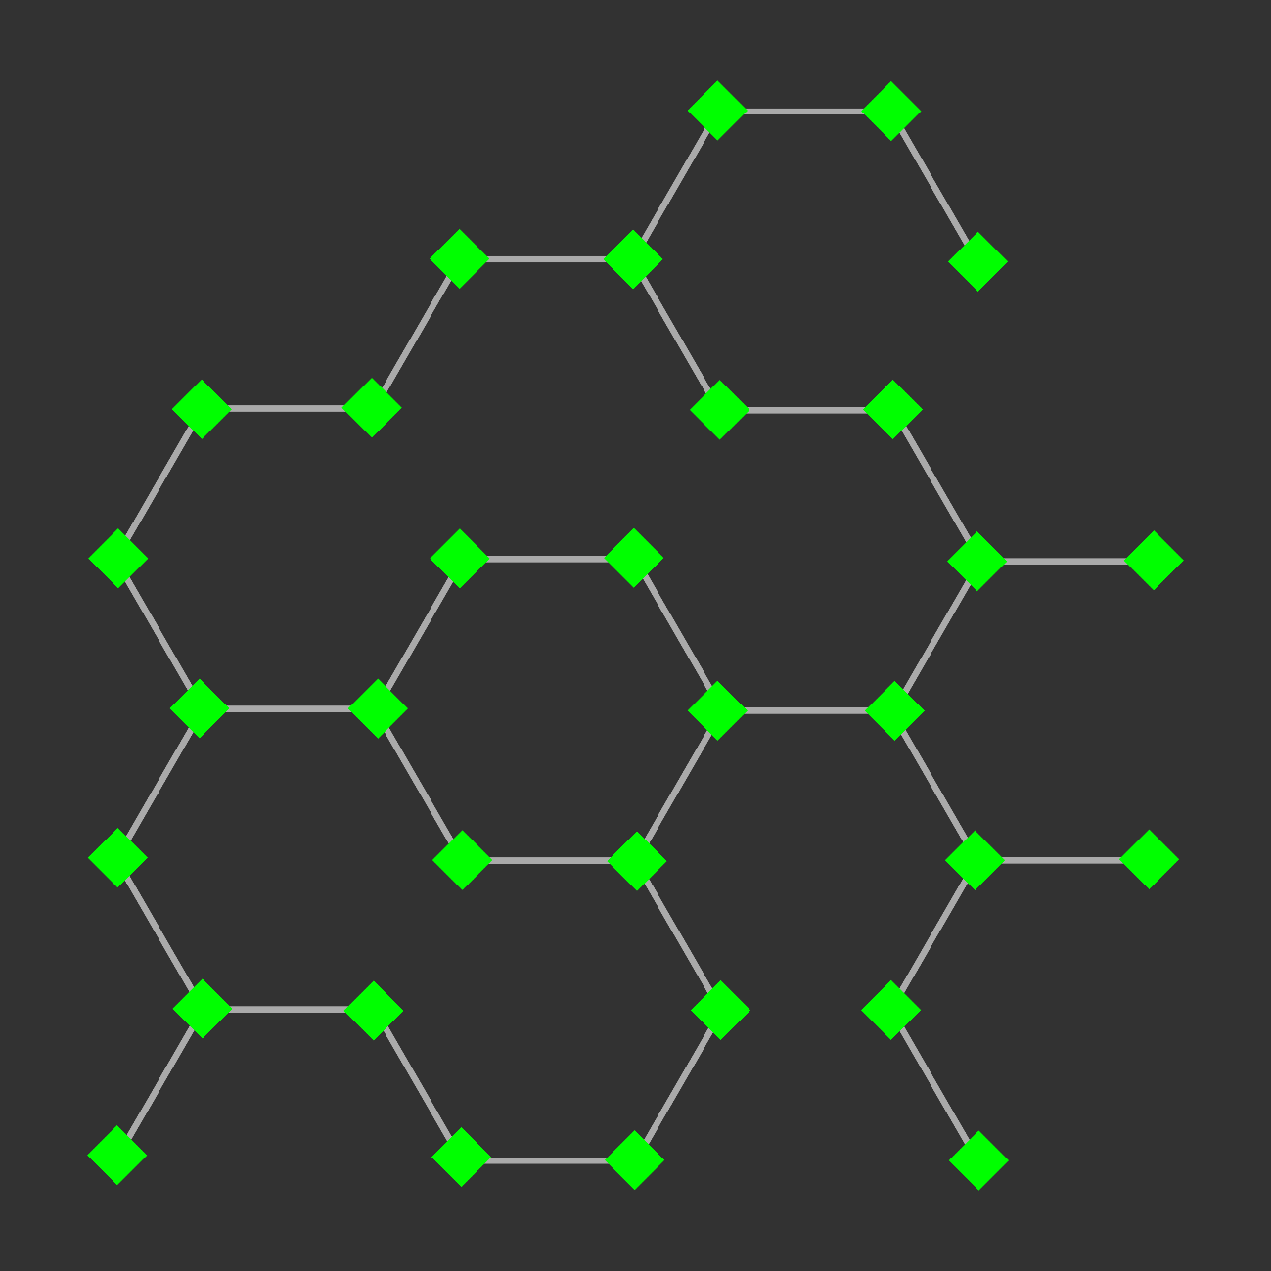
Network Visualization: Exploration And Analysis

Slide 32
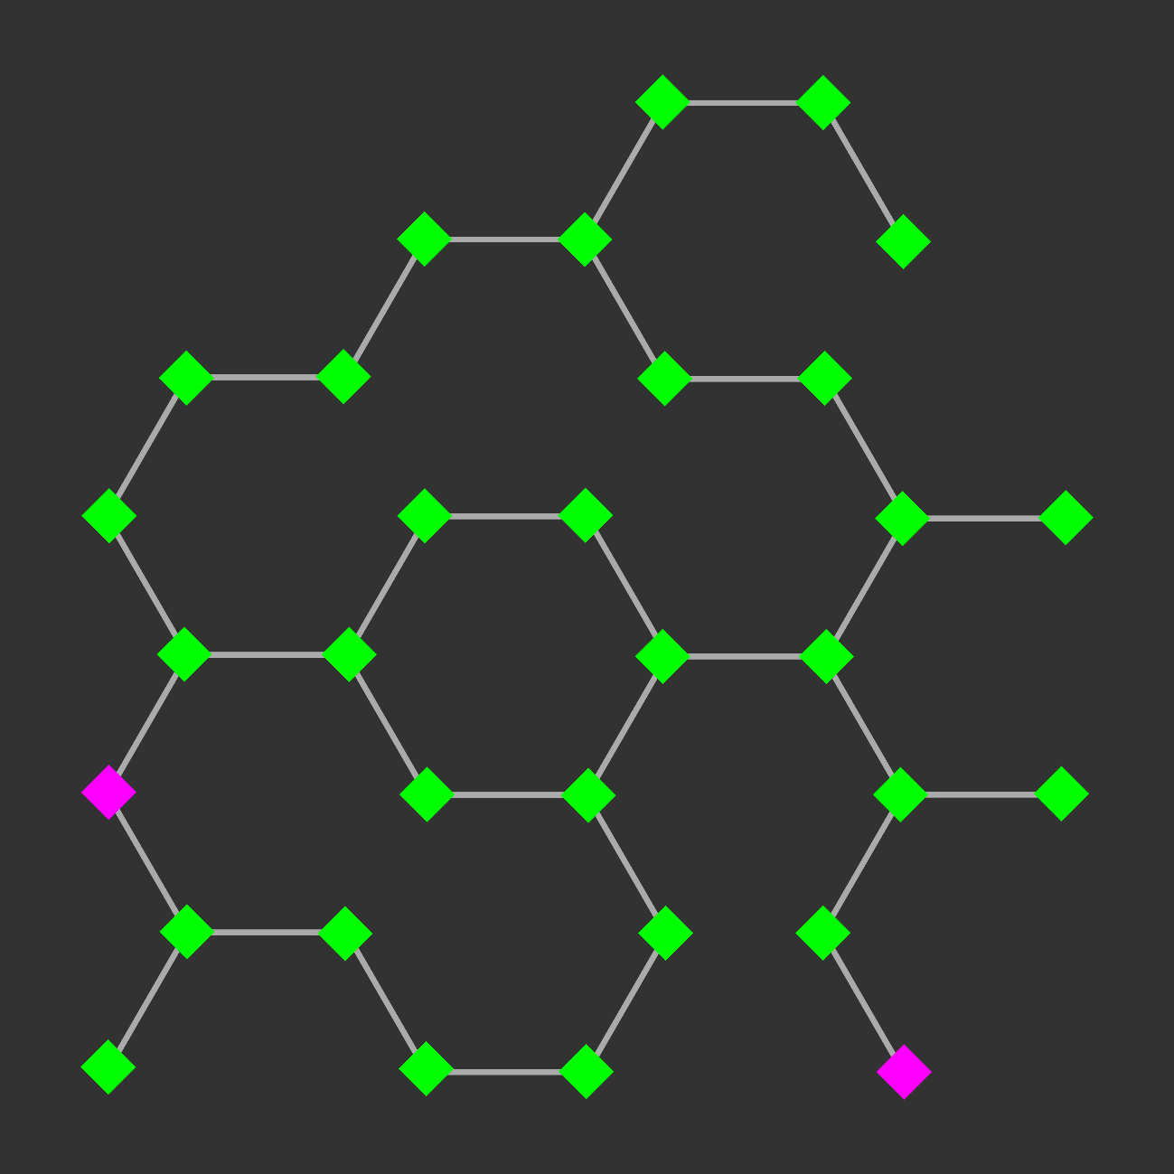
Network Visualization: Exploration And Analysis
Find paths between nodes:
- Shortest path

Slide 33
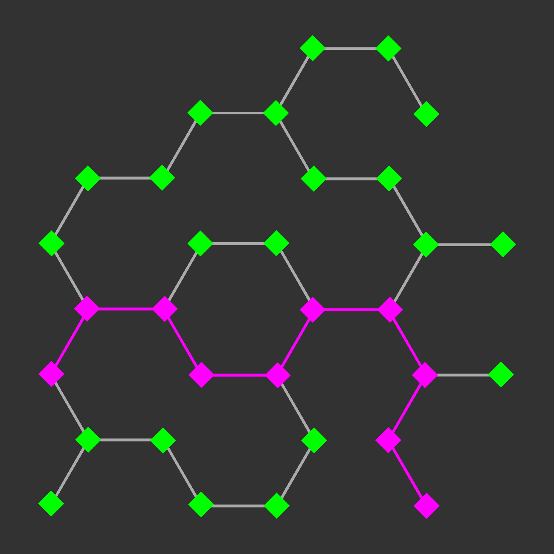
Network Visualization: Exploration And Analysis
Find paths between nodes:
- Shortest path

Slide 34
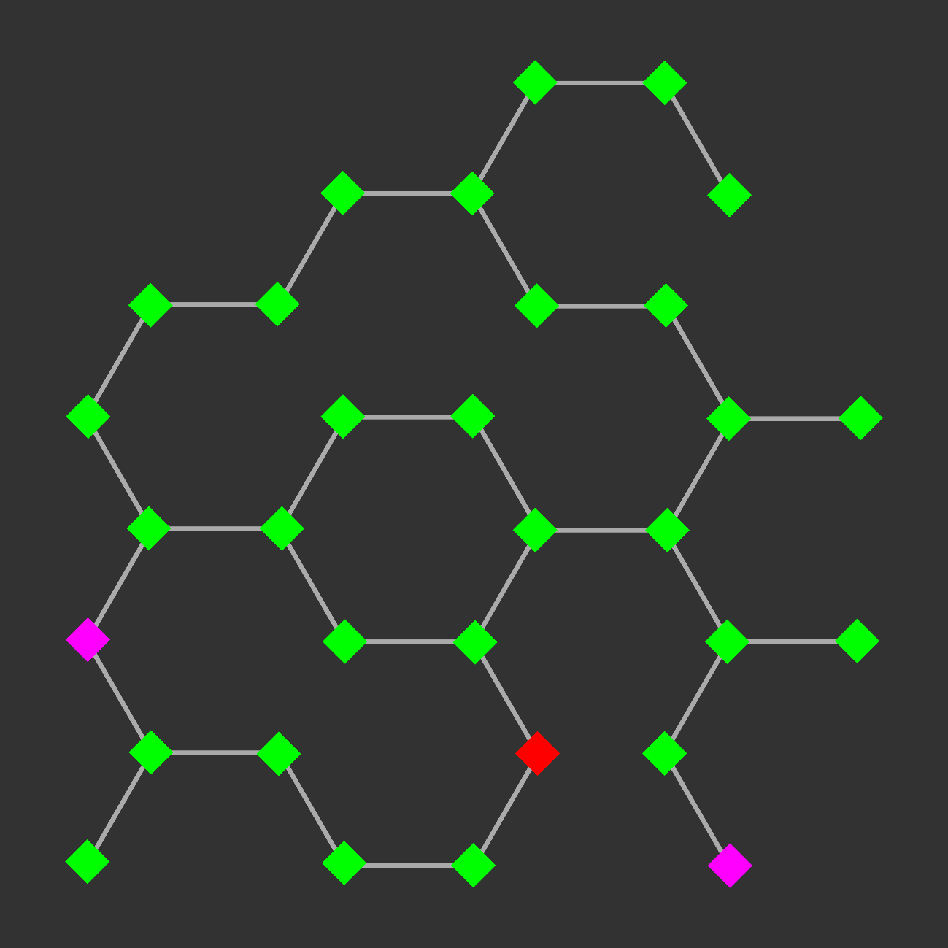
Network Visualization: Exploration And Analysis
Find paths between nodes:
- Shortest path
- Shortest path including or excluding another node or classification
- Path with greatest flux rate

Slide 35
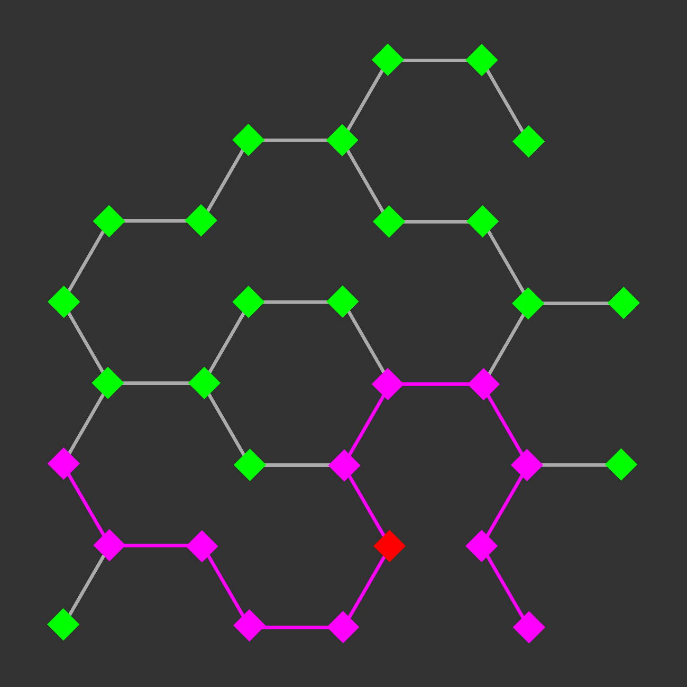
Network Visualization: Exploration And Analysis
Find paths between nodes:
- Shortest path
- Shortest path including or excluding another node or classification
- Path with greatest flux rate

Slide 36
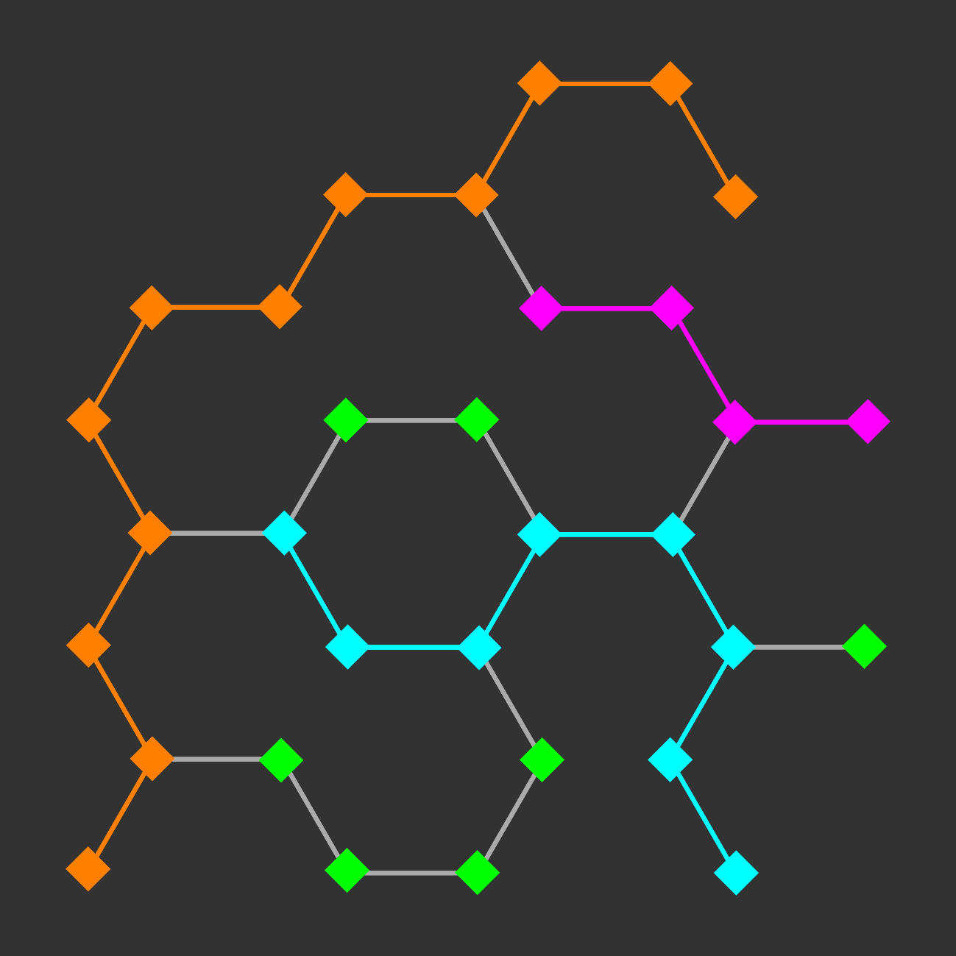
Network Visualization: Exploration And Analysis
Find paths between nodes:
- Shortest path
- Shortest path including or excluding another node or classification
- Path with greatest flux rate
- Specific metabolic pathway

Slide 37
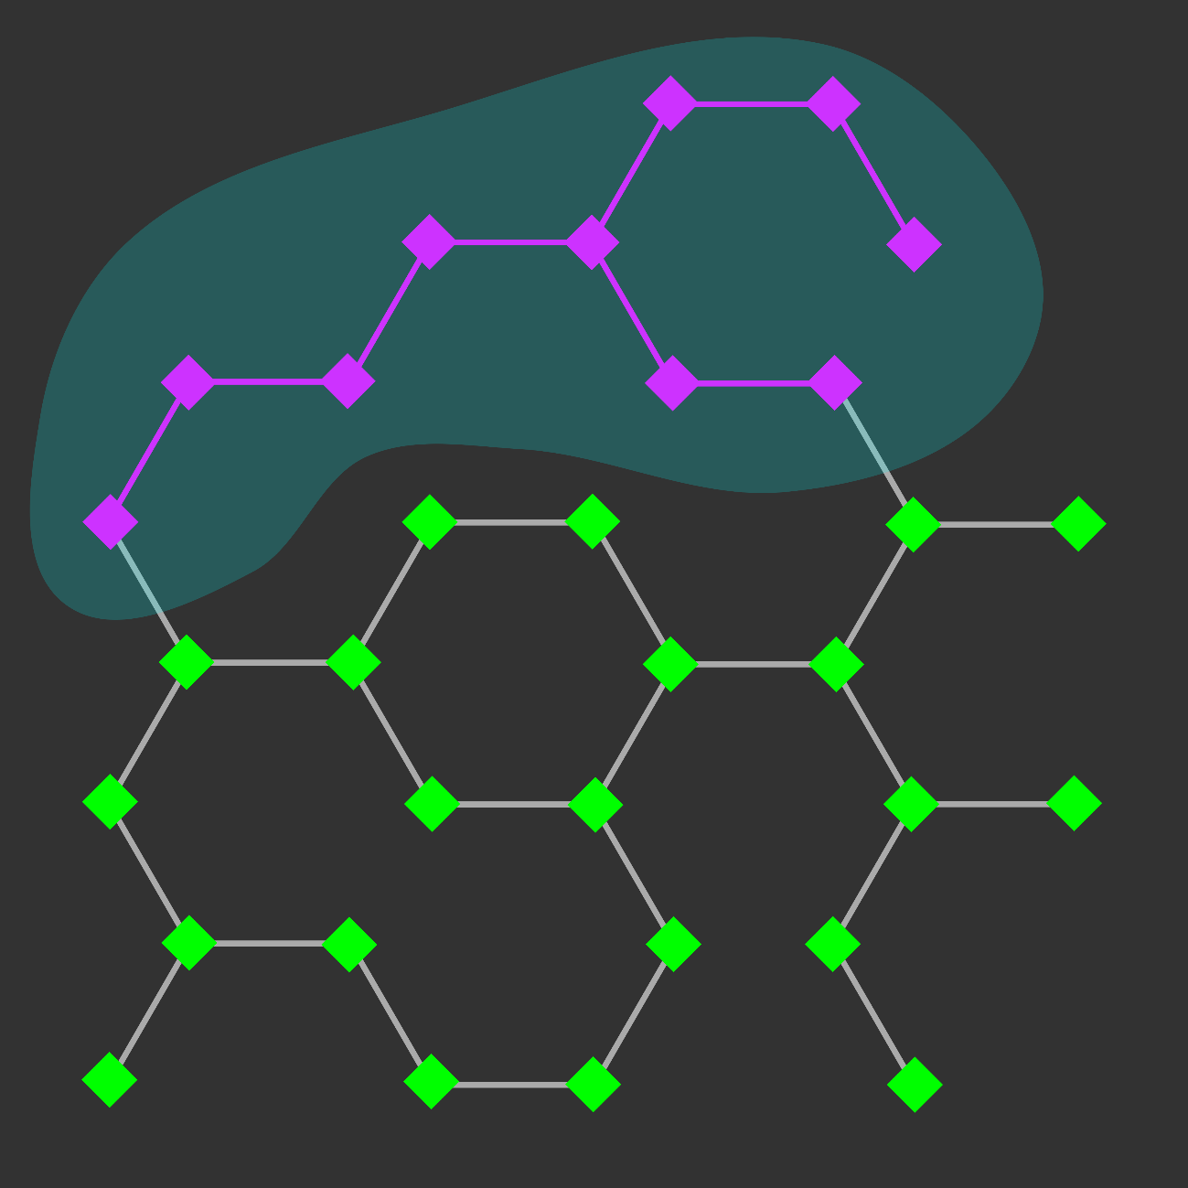
Network Visualization: Exploration And Analysis
Find paths between nodes:
- Shortest path
- Shortest path including or excluding another node or classification
- Path with greatest flux rate
- Specific metabolic pathway
- Specific cellular compartment

Slide 38
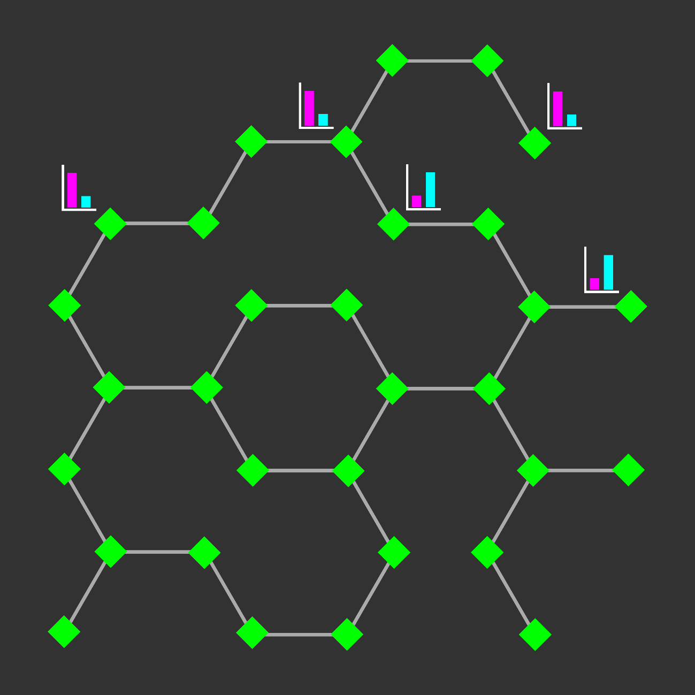
Network Visualization: Exploration And Analysis
Find paths between nodes:
- Shortest path
- Shortest path including or excluding another node or classification
- Path with greatest flux rate
- Specific metabolic pathway
- Specific cellular compartment
- Paths between all nodes with significant change in experimental data

Slide 39
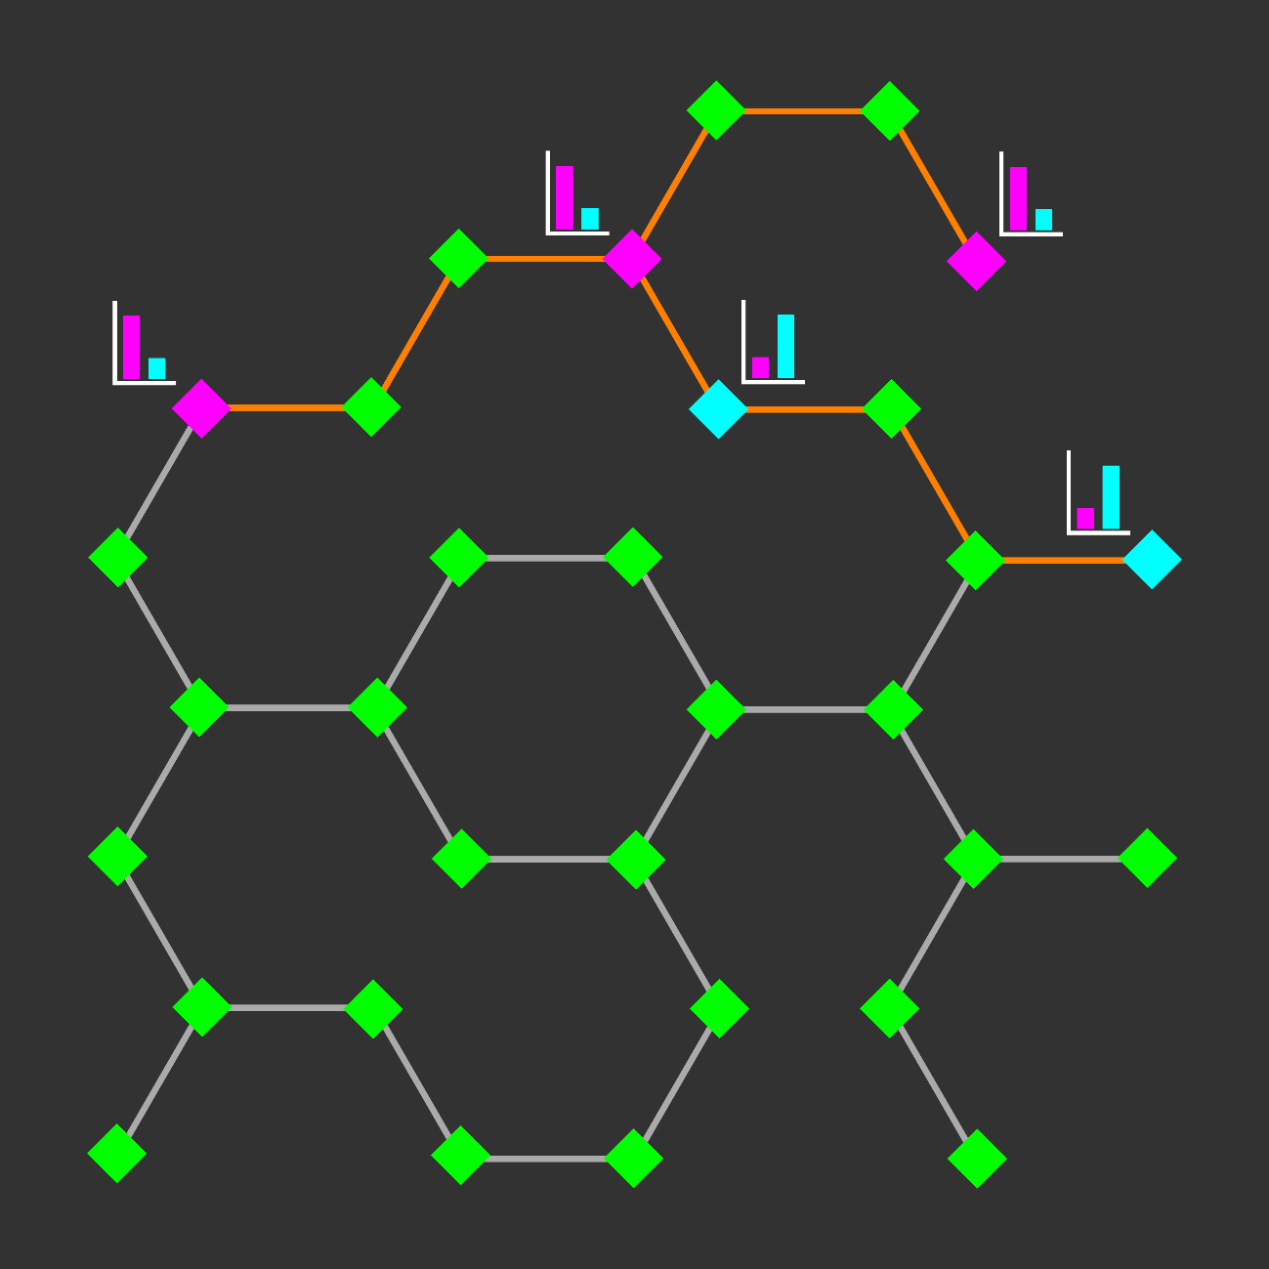
Network Visualization: Exploration And Analysis
Find paths between nodes:
- Shortest path
- Shortest path including or excluding another node or classification
- Path with greatest flux rate
- Specific metabolic pathway
- Specific cellular compartment
- Paths between all nodes with significant change in experimental data

Slide 40

Network Visualization: Exploration And Analysis
Find paths between nodes:
- Shortest path
- Shortest path including or excluding another node or classification
- Path with greatest flux rate
- Specific metabolic pathway
- Specific cellular compartment
- Paths between all nodes with significant change in experimental data
Recognize trends:
- Find common features of multiple nodes with significant change in experimental data

Slide 41





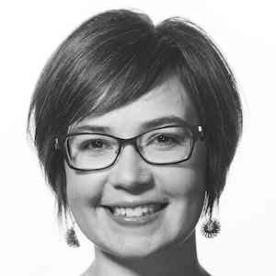
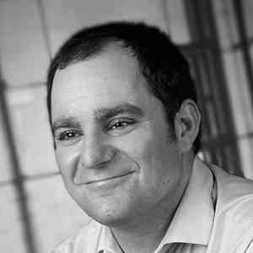
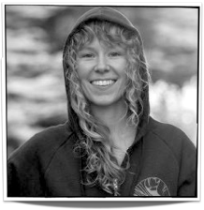





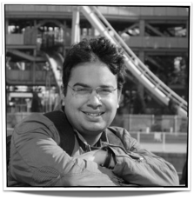
Ethan Kerzner
Alex Bigelow
Sean McKenna
Sam Quinan
Miriah Meyer
Alexander Lex
Nina McCurdy
Jimmy Moore
Asmaa Aljuhani
Carolina Nobre
http://vdl.sci.utah.edu/
Cameron Waller
Magdalena Schwarzl
Sunny Hardasani
Alexander Lex, August 2016

